Slide 1
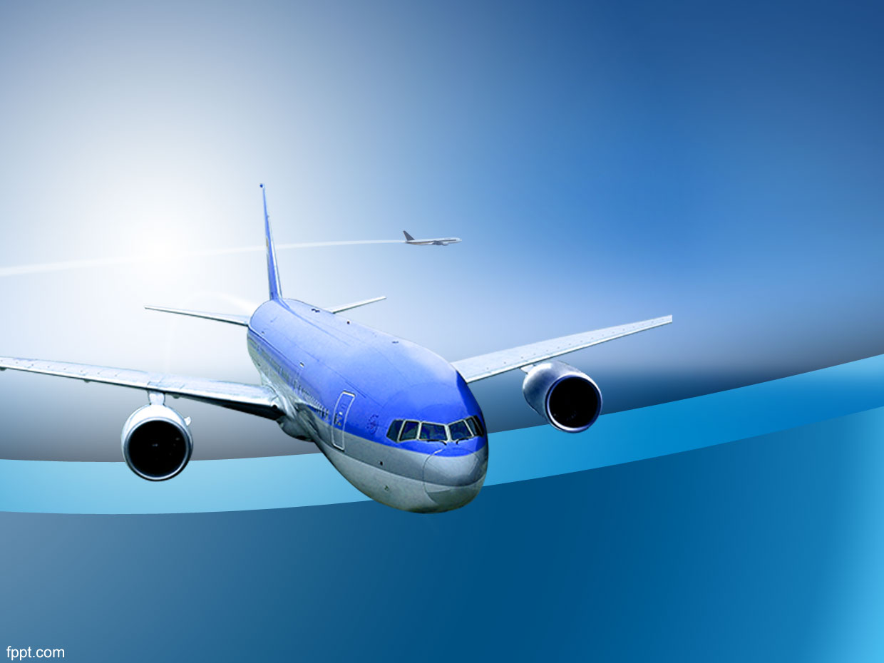
How Safe is Airlines?
Executive Summary
By: Vinay Nagaraj

Slide 2
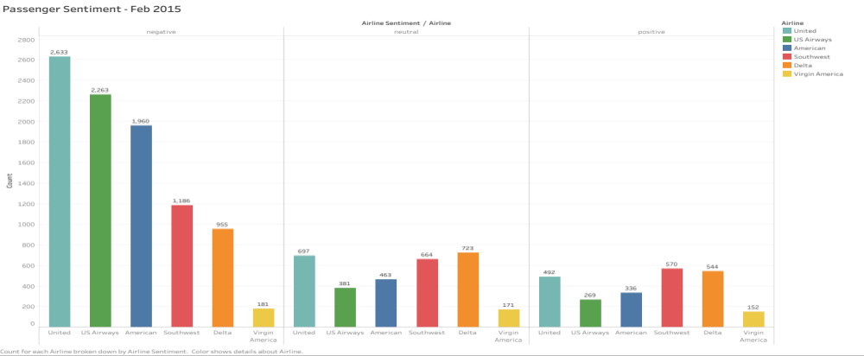
Passenger Sentiment – Feb 2015
Twitter data showing Airline Passenger Sentiment
More Negative than Neutral or Positive
Reason why next slides are very important for Airline Industry.

Slide 3
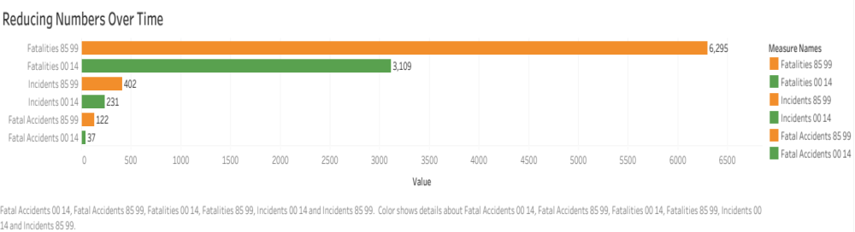
1985-99 vs 2000-14
With the advent of technology, Fatalities/Incidents/Fatal Accidents have reduced over time.
The counts have almost reduced by 50% when we compare the data from 1985-99 vs 2000-14

Slide 4
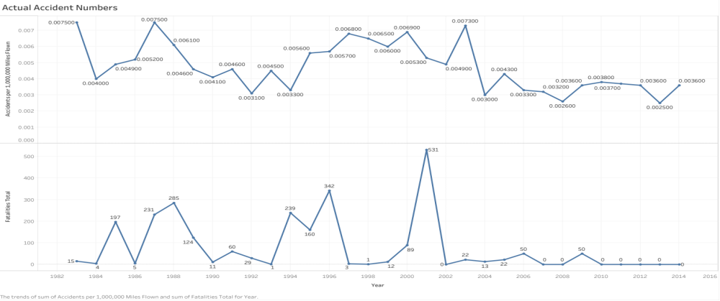
Actual Accident Numbers
For a Million miles flown, we see 0.0036 accidents. Over the last decade the numbers have drastically reduced.
2001 had the highest fatality of 531 after which the numbers are very low.

Slide 5
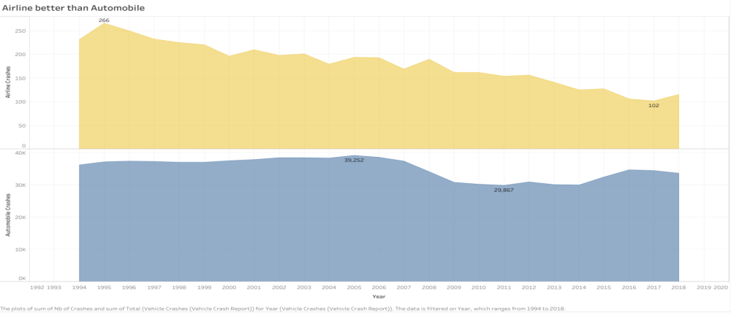
Airline vs Automobile
A clear indication that Airline is the safest mode of transportation.
1995 saw the maximum number of Airline crash – 266.
2005 saw the maximum number of Automobile crash – 39,252.

Slide 6
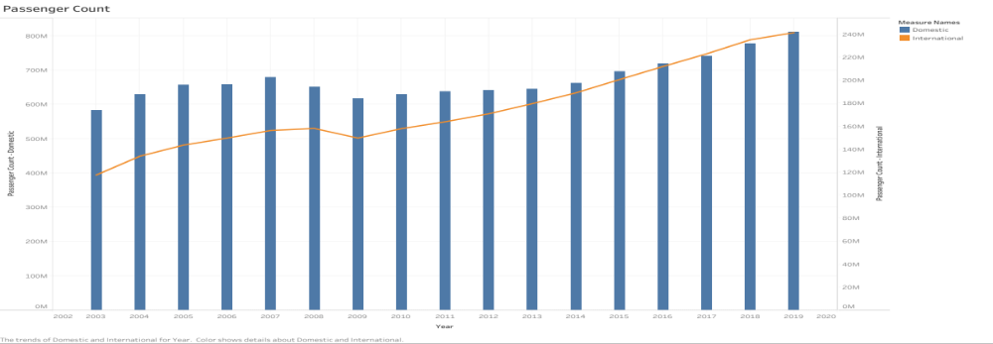
Passenger Count
Proudly enabled a little over 1 Billion passengers in 2019 to reach their desired destinations.
Domestic passengers in 2019 – 811,547,169.
International passengers in 2019 – 241,442,545.

Slide 7
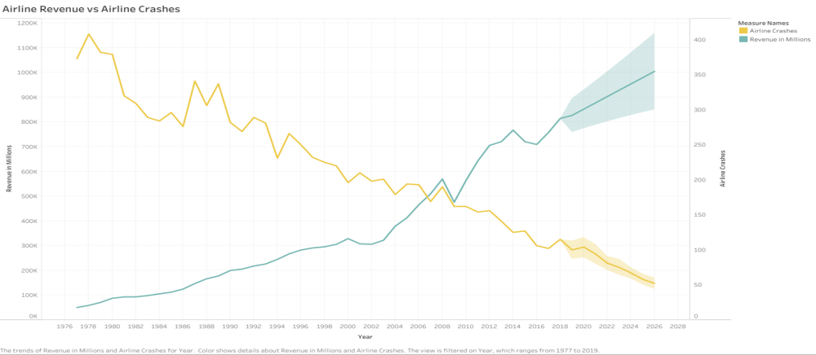
Revenue vs Crash
Revenue and Crash are inversely proportional. Safety is the top priority to keep the cash register happy.
If we maintain the trend, we see our revenue increasing at a good rate.

Slide 8
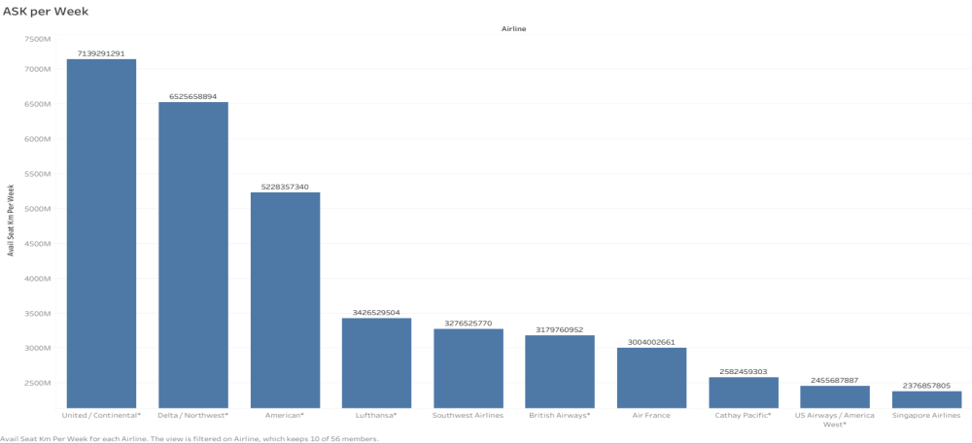
Available Seat KM/Week
This shows Airlines with maximum ASK per week.
United Airlines is the highest followed by Delta and American.

Slide 9
References:
https://www.kaggle.com/fivethirtyeight/fivethirtyeight-airline-safety-dataset
https://catalog.data.gov/dataset/accidents-fatalities-and-rates-1995-through-2014-for-u-s-air-carriers-operating-under-14-c
https://www.kaggle.com/crowdflower/twitter-airline-sentiment
https://www.bts.gov/topics/airlines-and-airports-0

Slide 10
Thank you !!

